Slide 1

Cybersecurity
Activity Kit

Slide 2
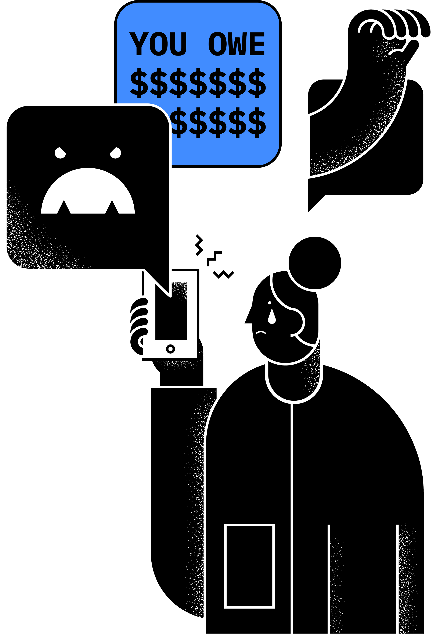
Cybersecurity is protecting yourself from someone stealing your digital information or from someone pretending to act as you online

Slide 3
Do you have a smart phone?

Slide 4
Do you shop online?

Slide 5
Do you have a social media account?

Slide 6
Do you stream movies or tv shows?

Slide 7
Do you download apps?

Slide 8
Did you answer yes to any of these questions?
It’s time to
talk about cybersecurity

Slide 9
Content
Protecting yourself
Taking control of your data
Careers in cybersecurity
Notes:
In this presentation, we'll be covering three core topics around cybersecurity; Protecting Yourself, Taking Control and Careers

Slide 10
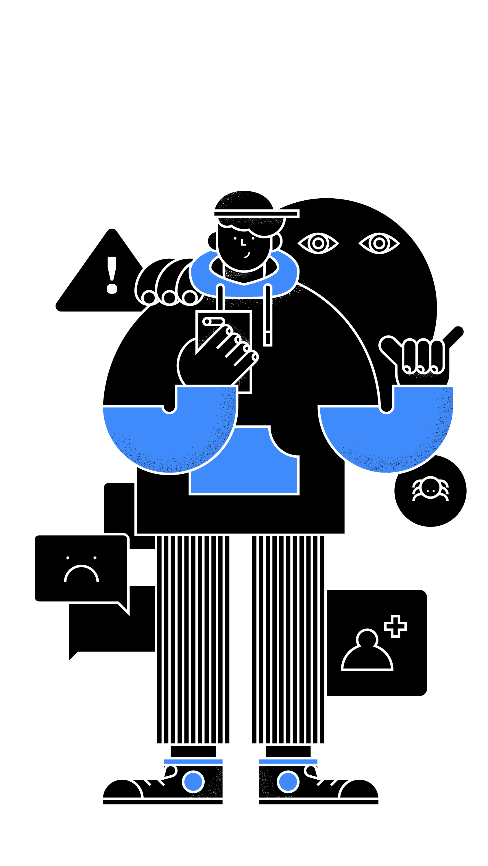
Protecting yourself

Slide 11
What do you think your points of risk are?
Protecting yourself / Exercise
Notes:
Let’s do an exercise to get started that will help us understand why we need to protect ourselves.

Slide 12
Ground
Rules
Protecting yourself / Exercise
Show, don’t tell
Less talking, more writing
Less writing, more drawing
Everyone has a Sharpie
Quantity over quality
Fail early, learn fast
Encourage the absurd
Embrace discomfort
Yes! And...
Have fun!
Notes:
As we are about to do a group exercise, here are some ground rules.

Slide 13
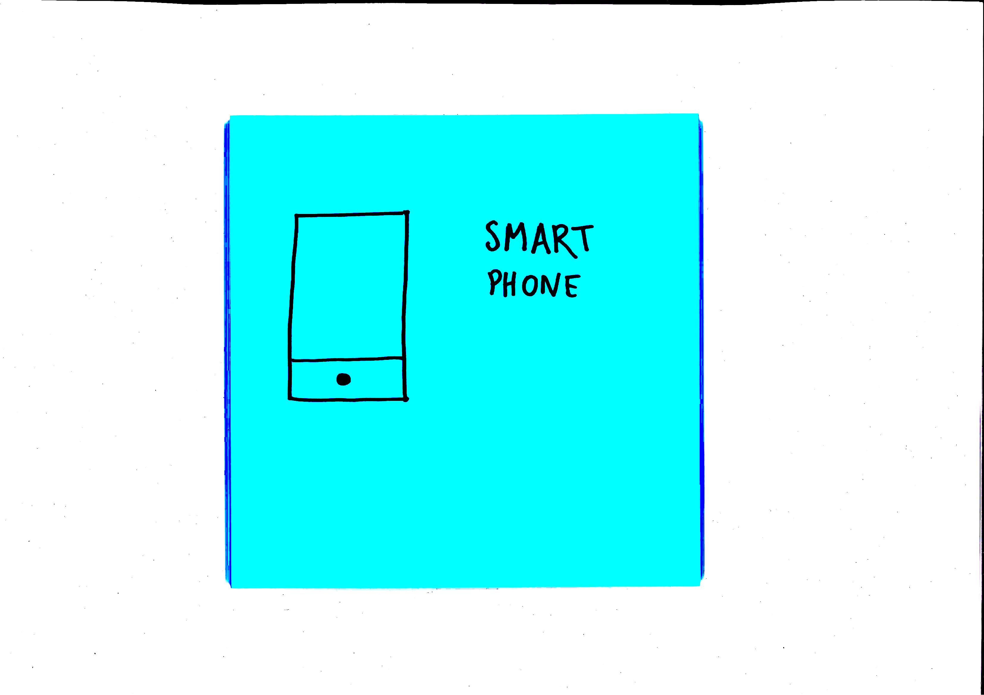
Protecting yourself / Exercise
Individually, make a note of things
you come into contact with every day
that could put you at risk
Each team member generates at least
3 points of risk
Not too much detail—be visual
Put each vignette up on the wall
Cluster similar ideas
15 minutes
Sketch + Headline + Caption
Notes:
These can be physical things like a phone or virtual things like email.
[read slide]
Note that no artistic skills are required for sketching. Stick figures with speech bubbles and simple charts are sufficient.
The main rational why we are asking you to sketch your idea is because a visualization is often less ambiguous than some written text.

Slide 14
Protecting yourself / Exercise
Individually, make a note of things
you come into contact with every day
that could put you at risk
Each team member generates at least
3 points of risk
Not too much detail—be visual
Put each vignette up on the wall
Cluster similar ideas
15 minutes
It should look something like this
Notes:
CLUSTER SIMILAR IDEAS: 10 MINS
Each team should discuss their ideas, cluster similar post its, and identify themes. Draw a circle around the clusters and label them with the common them, for example “social media accounts”

Slide 15
Playback
Notes:
PLAYBACK: 10 MINS
Each group should nominate one person to quickly playback their ideas to the wider group

Slide 16

Great work!
You’ve identified many key cybersecurity areas.
Protecting yourself / Checklist
Notes:
Now that you’ve identified key cybersecurity areas, let’s quickly run through how to protect yourself.

Slide 17

Protecting your devices
Protecting yourself / Checklist
Set up a PIN or a biometric identifier, like a fingerprint
Update your operating system & apps
Consider security software
Keep your Bluetooth and WiFi off whenever possible
Notes:
Be sure to set up a PIN or a biometric identifier, like a fingerprint, on all you devices in case they are picked up or stolen by a third party.
Updating your operating system and applications, deleting those you don't use - Software developers aren't perfect people, and sometimes software vulnerabilities fall through the cracks. Patches and new releases of operating systems often address these vulnerabilities, so your devices can stay safer and more secure when they are fully up to date on patches.
Security software (where should they go to find out what to get? --> They can do Windows Update, Firmware updates, and update their applications by going to "Help" and then "Updates")
Keep your Bluetooth and WiFi off whenever possible.

Slide 18
Public vs private Wifi
Protecting yourself / Checklist
Only use trusted private networks, and ones that are secured with an access password when:
Using personal accounts
Transmitting private or work information
Paying for something online
Notes:
For example, an open WiFi that does not require a password to use it, like public networks in coffee shops, airports, and anywhere else around town
Connecting to open, unsecured WiFi networks
We access the internet through what's called an IP Address. IP stands for Internet Protocol and "address" means a unique number that gets linked to all online activity you do. It's just like a phone book.
Public vs private WiFi:
Other people can monitor your activity on unsecured WiFi connections. For example, an open WiFi that does not require a password to use it, like public networks in coffee shops, airports, and anywhere else around town. Make sure you only use trusted private networks, and ones that are secured with an access password when you're using personal accounts, transmitting private or work information, and when you want to pay for something online.

Slide 19
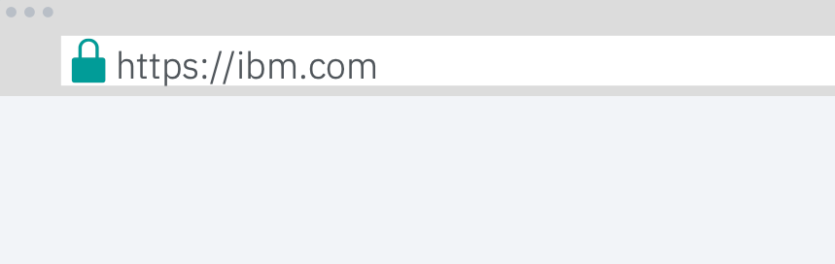
Entering sensitive information online
Protecting yourself / Checklist
Are you on trusted private wifi?
Is the page secure? Check if the URL is "https" instead of “http"
Do you know and trust the vendor?
Look out for the little ‘Secure Connection’ lock icon in the browser search bar.
Notes:
Entering credit card details, PII, and sensitive info (buying online, ecommerce):
Is the page secure?
Look for the little lock icon in the browser search bar before entering in your credit card.
Check if the URL is "https" instead of "http". SSL Certificates, which stand for Secure Sockets Layer, is a technology that enables encrypted communication between a web browser and a web server, which can help secure the privacy of your credit card number during a transaction.
Do you know and trust the vendor?
If you're shopping online, read reviews to see if the company is legit.
Don't send details in an email or SMS message

Slide 20
Email
Security
Protecting yourself / Checklist
Be careful downloading files and attachments
Don’t open spam
Be wary of email scams, e.g. romance
Don’t share sensitive information in an email
Learn to spot phishing scams
Notes:
Downloading files and attachments
Other kinds of scams (romance) and spam – If it seems too good to be true it probably is.

Slide 21
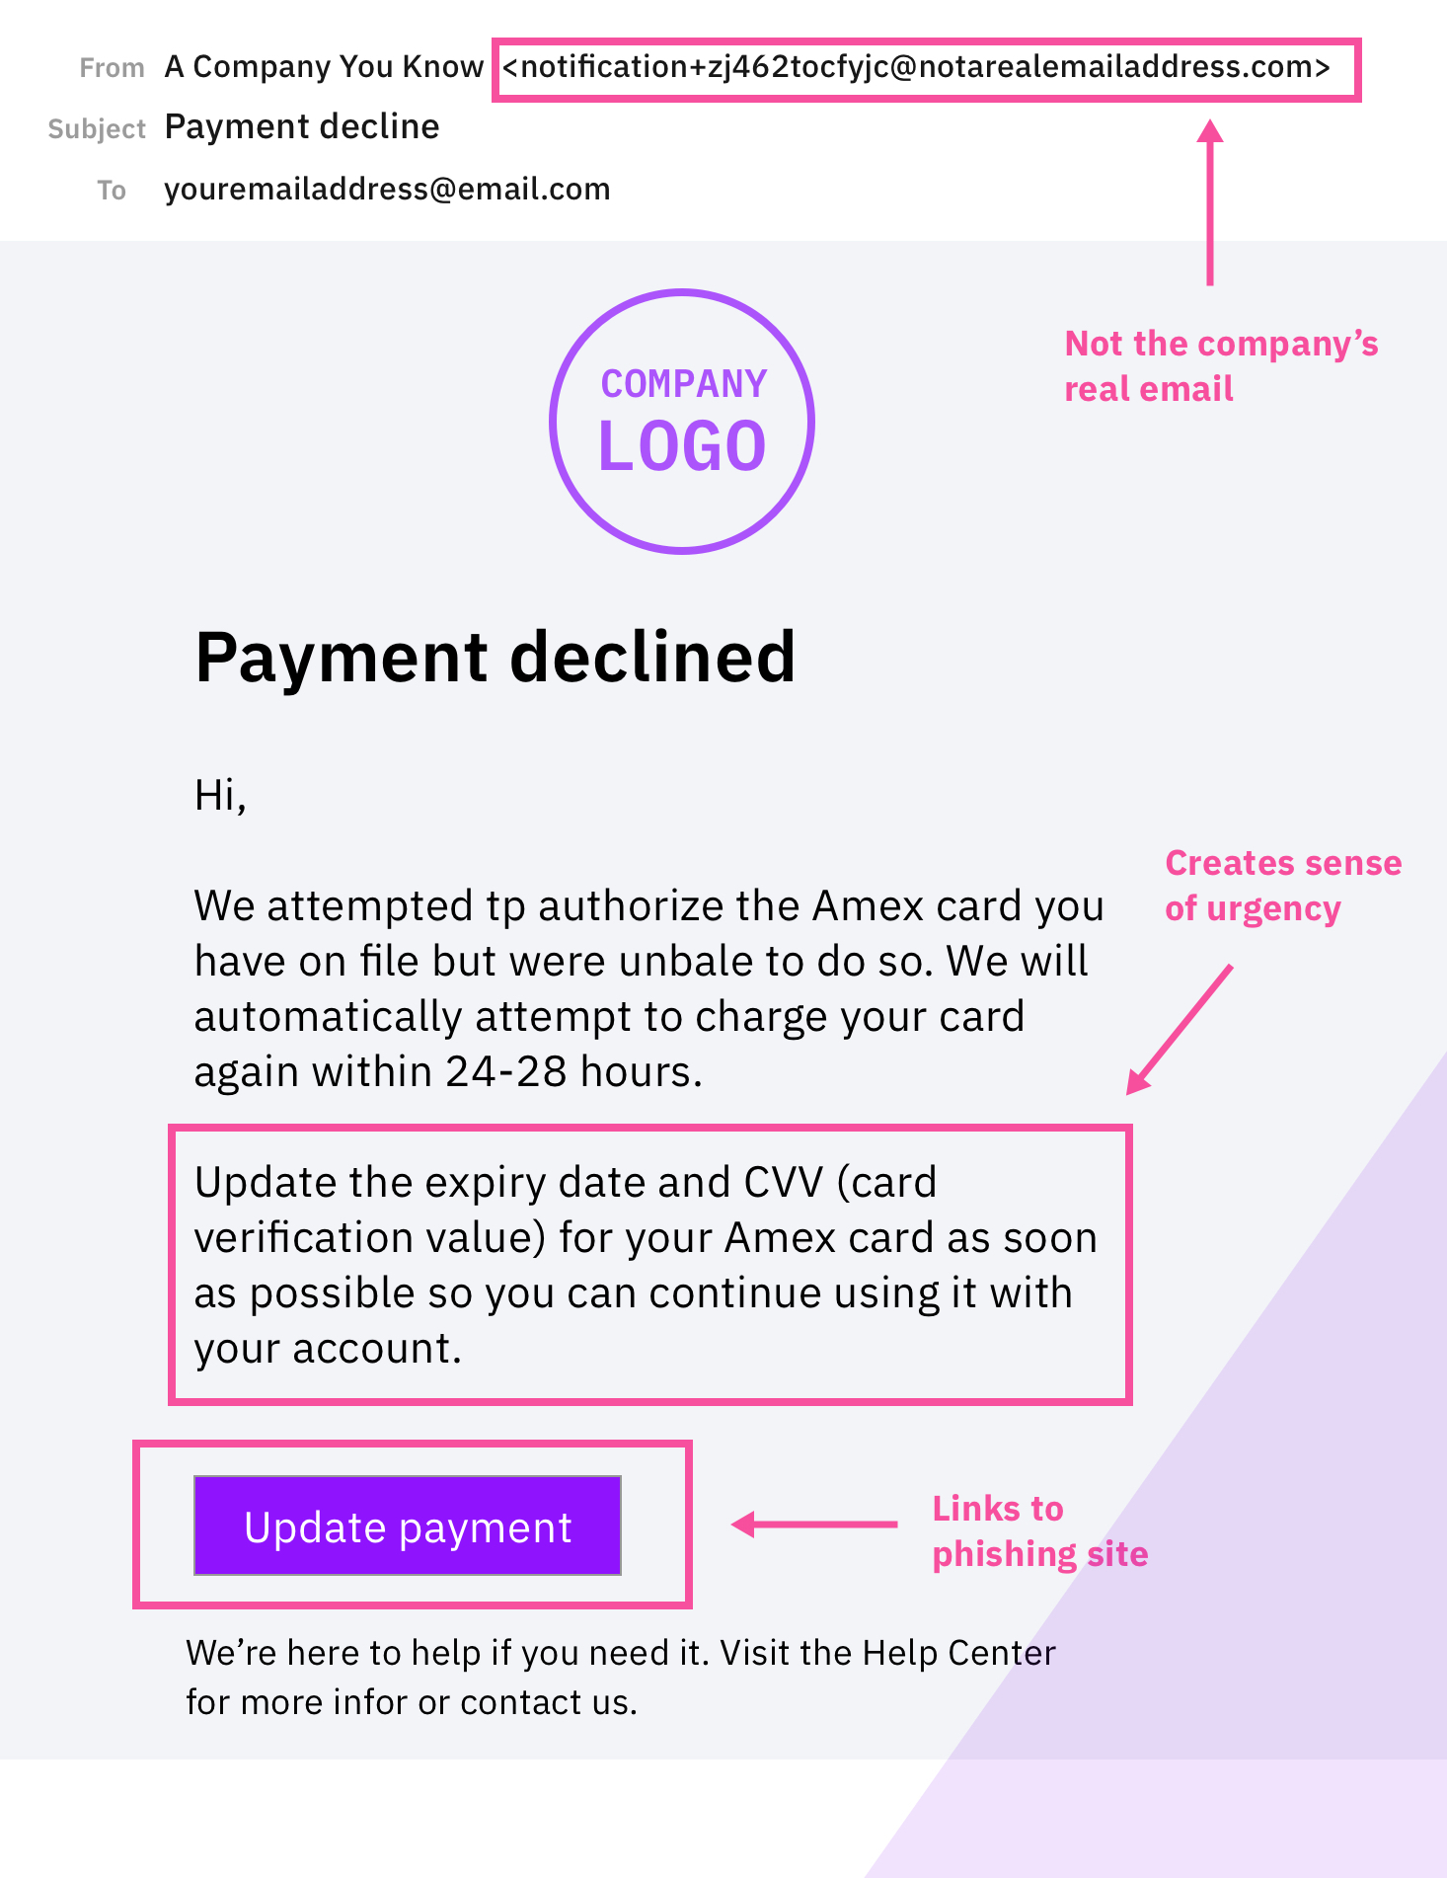
How to spot phishing scams
Protecting yourself / Checklist
Notes:
What is phishing? Phishing the practice of sending emails that appear to be from trusted sources with the goal of gaining personal information or influencing users to do something.
Here’s an example of a phishing email. Note what to look out for.

Slide 22
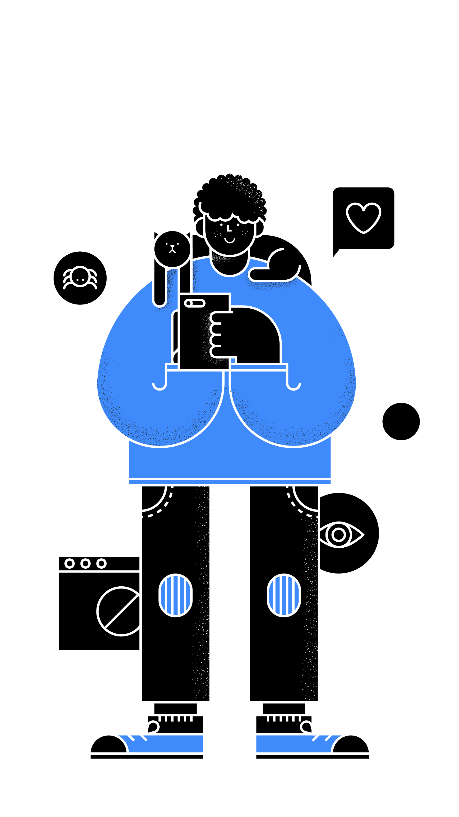
Storing information online
Protecting yourself / Checklist
Do I trust the service that's storing
the information?
Is it okay if this information becomes public?
Notes:
Ask yourself these two questions:
Do I trust the service that's storing the information?
Is it okay if this information becomes public?

Slide 23
Protecting access to your information
Protecting yourself / Checklist
Don't use passwords, use passphrases
Don't use any public information about yourself
Setup 2 Factor Authentication (2FA)
Don't reuse your passwords
Use password managers
Update your password regularly
Notes:
Protecting access to you information
Don't use passwords, use passphrases. Those are longer, take more effort to crack, and are much easier for you to remember. Don't use any public information about yourself like your middle name, dog, favorite sports team, as your password.
2 Factor Authentication (2FA) - A security process that allows you to verify yourself in two ways to better protect the accounts you are accessing. Also known as MFA (multi-factor authentication) for cases where more than 2 elements are used.
Don't reuse your passwords across different web sites and accounts.
Password managers
Update your password regularly

Slide 24
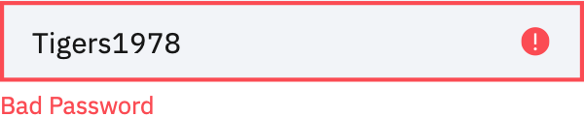
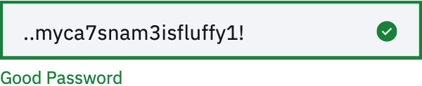
How to write good passwords
Protecting yourself / Checklist
Use capital letters, symbols, etc.
even when they’re not required.
Notes:
Good passwords have at least six characters and include nonalphabetic characters. Strange word combinations and words purposely misspelled are also good choices.
A good rule of thumb: Use capital letters, symbols, etc. even when they’re not required.

Slide 25

Downloading from the internet
Protecting yourself / Checklist
Only ever download content from
reliable sources.
Apps, music, videos and general files from dodgy sources can include viruses and malware that will be used against you.
Notes:
Downloading from the internet (streaming movies and music)
Only ever download content from reliable sources. Apps, music, videos and general files from dodgy sources can include viruses and malware that will be used against you.

Slide 26
Sending information online
Protecting yourself / Summary
There are ways for people to intercept data you are sending while it's en-route. Email, chat messages, private photos, even video calls can be heard by someone you don’t want to share it with.
Don’t send information that you wouldn't want to someday become public.
Notes:
There are ways for people to intercept data you are sending while it's en-route. This means that any email, chat messages you exchanged with a friend, private photos, or even a video call can be heard by someone you don’t want to share it with. Don’t send or upload information that you wouldn't want to someday become public, even if you believe you are doing so on a private channel or group. Anything at all can fall into the wrong hands.

Slide 27
What is encryption?
Protecting yourself / Summary
You might notice that some websites and messaging platforms use encryption:
Encryption can protect data by scrambling it and locking it with a special key
Even encryption can sometimes be broken by someone else
The safest thing to do is not to send, share, or upload any information that you wouldn't want to someday become public
Remember: once something is public on the internet, you may never be able to delete it again.
Notes:
You might notice that some websites and messaging platforms you use encryption. In some cases, it’s also called “end-to-end encryption”, which means the data is protected throughout its journey. Encryption is the process of protecting data by scrambling it and locking it with a special key. Without that key, or set of keys, unauthorized people won’t be able to read it even if they got access to it. Encryption can protect any kinds of data, such as messages sent over the internet, emails, chats, photos, or documents stored on a laptop, to name a few. However, even encryption can sometimes be broken by someone else. The safest thing to do is not to send, share, or upload any information that you wouldn't want to someday become public. Remember: once something is public on the internet, you may never be able to delete it again.

Slide 28

Taking control of your data

Slide 29
Digging for data
Taking control of your data / Exercise
Individually, create a list of companies, apps, services etc. that have access to your data.
Look through your phone, email, computer apps
10 minutes

Slide 30
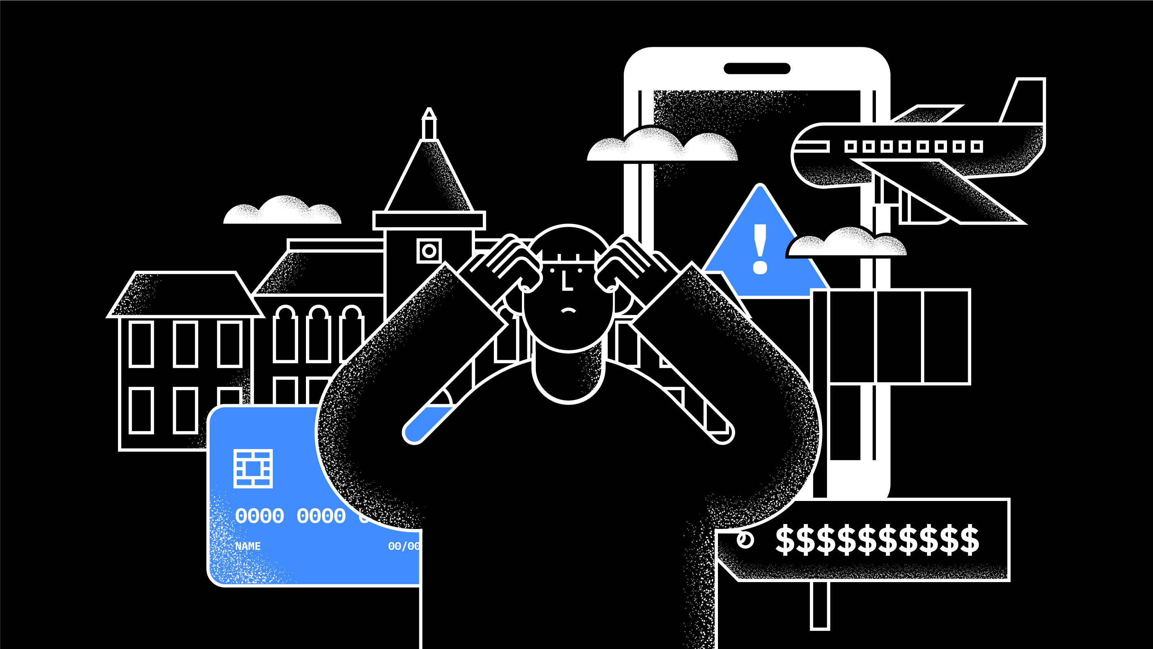
How many did you count?
Notes:
Go around the room and have the students read out how many they counted and give examples

Slide 31

Data privacy refers to the way data is collected, shared and used online.
Taking control of your data
Notes:
Data is what fuels big tech and social media companies.
What is considered "data"?
Data is basically any information that is collected about you.
What are all the data points out there about me?
Your personal information, your medical history, your posts, the content of your profile, personal messages sent, your credit score, your address, etc. - anything you put out into the internet becomes "data"
When we sign up for products and services online, we are giving consent for those companies to utilize and sometimes even own that data.
How data is collected
Data is what fuels big tech and social media companies
This can be good. The internet can tell you if your route has lots of traffic because people are consenting to have their data collected.
Referencing their list, ask the students what other ways they see data being used in a way that helps their lives
But this can be bad if the right data gets into the wrong hands.
Big companies track you constantly. Once you have consented to data collection, they are able to see your movements, purchases, read your emails, etc.
Lots of data breaches we know are after money or personal information that could be used to get access to money, but recently stories have come out about how data can be used to influence and manipulate society
Referencing their list, ask the students if they think there are any other downsides to data collection

Slide 32
But you can take back control of your data
Taking control of your data
Notes:
The way you do this is by being aware of when you are giving your consent and understanding how the companies you interact with are using your data.

Slide 33



How data is shared
Taking control of your data
Company to company
Taking control of your data
Careers in cybersecurity
Notes:
Company to company
Advertising - ever wondered why your ads seem so specific?
Many Social media companies track your activity and sell your data to 3rd party companies for advertising. They advertise based on your profile, age, gender, likes, and who you follow.
Social media companies can put together a pretty detailed profile of you just based on your activity and profile.
Beyond those ads being pesky or a little creepy, we can't deny they sometimes work. Taking control of your data and not letting companies sell your data to third parties means you're less likely to be taken advantage of or potentially influences through targeted ads.
Person to person
Every time we contact a friend, family member, or colleague on an internet connected app, we share data
Online messaging platforms
It is best to be aware that these companies, even though they may take security very seriously, aren't foolproof. Try not to say anything that you wouldn't want to one day be public.
Person to company
We volunteer data to companies to use their services eg. when we provide our bank account details to payment apps so that we can split checks and send money to friends
We share data when we send money to each other.
Make sure you're sending to the right person, through a service you trust.

Slide 34

Practice consent
Taking control of your data / Checklist
Read terms & conditions
Look into app privacy settings
Review your location settings
Keep your microphone turned off
Notes:
Terms & Conditions
Long and tedious but it is important to know what you're signing up for.
When in doubt, investigate the company further to see if they are trustworthy.
No one is perfect. News stories come out all the time about companies who have data breaches. Use your best judgment but know that these things happen.
Privacy Settings
When using a new website or app, look into the privacy settings to see what data they are collecting. If something seems unnecessary, turn it off.
Think about apps you use often that probably know a lot about you. Check your privacy settings there to see how they are using your data.
If an app asks to use your microphone or location but it doesn't seem necessary, don't give them the permission. Take that extra second to consider the data you could be consenting to before making your decision.
Location settings - Allows companies to see where you are and gleam what you're doing, your habits, etc.
Microphone settings
Keep your microphone turned off when not in use. Some apps use what the microphone can capture to market targeted adverts to us. On many occasions, large technology companies were found at fault for listening to our conversations without our knowledge or consent.

Slide 35
Be mindful about what you’re putting out there
Taking control of your data / Checklist
    What have you consented to sharing?
    How will it be used?
    Is the company trustworthy?
    What responsibility does the company take for securing your data?
    Are you able to request your data that
    is being held?
    Are you able to delete your data?

Slide 36
Ask how your data will be used
Taking control of your data / Checklist
    Hospitals
    Insurance companies
    Retailers
    Mobile apps
    Banking
    At work
Notes:
Data gets collected in unexpected places – be
sure to ask how your data will be used in the following situations:

Slide 37
Data debate
Notes:
Group 1: Affirmative Stance
Data collection is a positive thing
Group 2: Negative Stance
Data collection is a negative thing
Select a topic for debate.
Break students into ‘for’ and ‘against’ with a few remaining as the judges.
Select an odd number of students to be your ‘supreme court’.
Allow the groups 10 minutes to prepare their stances.
The affirmative group has 2 minutes to present their case.
The negative group then presents their case in 2 minutes.
The groups now take 5 minutes to prepare their rebuttal arguments.
The negative group goes first with a 2 minute rebuttal, followed by the affirmative’s 2 minute rebuttal.
The judges have 5 minutes to discuss in private before delivering the ruling.

Slide 38
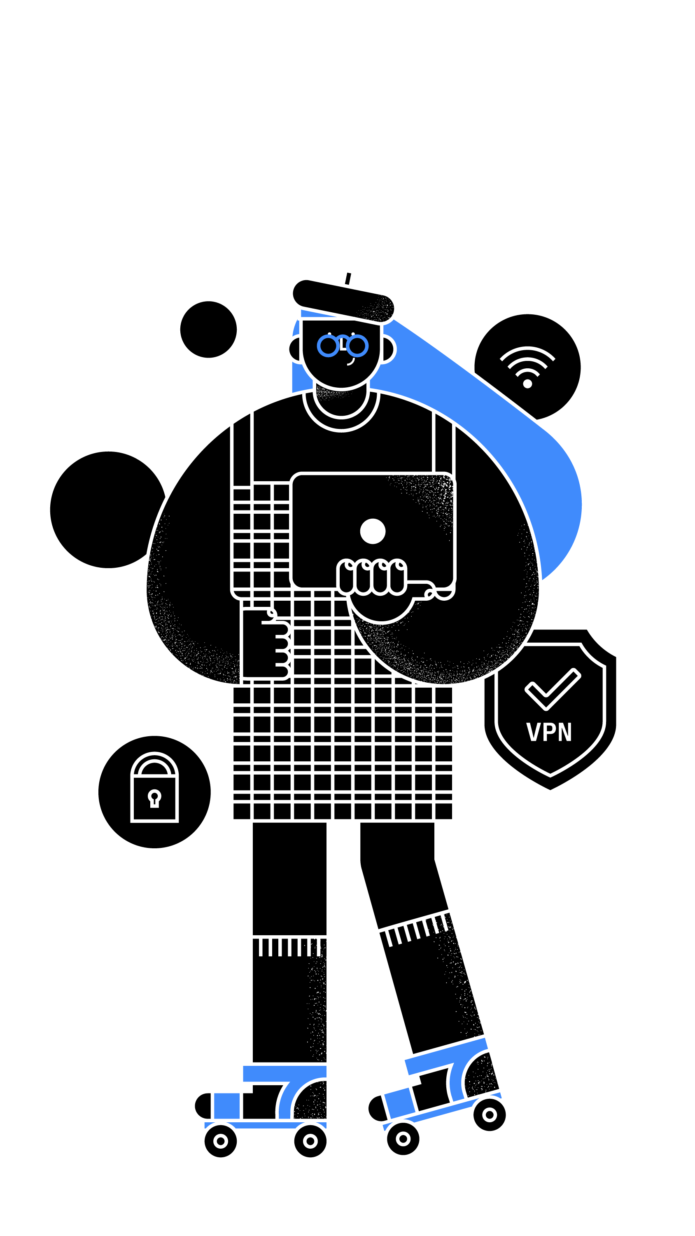
Careers in cybersecurity
Notes:
Now that you know more about cybersecurity, let's explore the types of careers you can have in the cybersecurity field

Slide 39
By 2021 3.5M cybersecurity jobs will be unfilled
Careers in cybersecurity
2019/2020 Official Annual Cybersecurity Jobs Report,
Herjavec Group
Notes:
Cybersecurity is a rapidly growing industry with plenty of opportunities and diverse roles
Reference: https://cybersecurityventures.com/jobs/

Slide 40



Primary roles
Careers in cybersecurity
Security Analysts
Incident Responders
Threat intelligence
Notes:
Security Analyst
A Security Analyst is responsible for ensuring that a company’s assets are protected from unauthorized access and use by monitoring network traffic and security, detecting and investigating suspicious behaviors and actions, and performing triage on alerts generated by security tools.
Incident responders
An Incident Responder is responsible for investigating in more detail and responding to detected security incidents, as well as providing advice during incident remediation. The Incident Responder also prepares reports that document on security incidents and the extent of the attack, based on forensic capture and analysis.
Threat intelligence
A Threat Intelligence Analyst researches and synthesizes information on attackers and tools of attack used to protect a company’s assets and defend against attack. The TI Analyst’s job is to keep abreast of new tactics, techniques, and procedures of attackers, understand the potential impact to the business, and inform incident response.

Slide 41
But there are many different roles and paths into Security…

Slide 42

Careers in cybersecurity / Role models
Creative director
Allison Ritter puts security lessons into action with her flare for drama.
Notes:
Read the full article here: https://securityintelligence.com/how-allison-ritter-puts-security-lessons-into-action-with-her-flare-for-drama/
To say Allison has a fast-moving job is an understatement. As the creative director at the X-Force Command Center, she’s responsible for the overall look and feel of the simulations and also plays an integral role in managing the multidisciplinary team that develops the interactive experiences for Cyber Range participants.
Based in Cambridge, Massachusetts, the Cyber Range drops clients into interactive breach simulations inspired by real-world cybersecurity scenarios. The immersive nature of the simulations helps security teams develop critical incident response and crisis management skills that can’t be learned from playbooks or how-to guides.
“I had the opportunity to help build the Cyber Range from the ground up,” she said. “This was a completely new space, so we had a lot of opportunities to create completely new experiences. What are the scenarios that we want to put people through? Visually, how do we want it to look?”
Allison is a self-proclaimed lover of drama, so it’s easy to see how she ended up with the Command Center. Her daily work brings the data breach simulations to life through her interactions with clients as they navigate through the scenarios.

Slide 43

Careers in cybersecurity / Role models
Security Gamification Engineer
Security gamification engineer Richard Moore proves that anyone can
be a hacker.
Notes:
Read the full article here: https://securityintelligence.com/security-gamification-engineer-richard-moore-proves-that-anyone-can-be-a-hacker/
Richard Moore makes his living literally building games.
Richard’s work as a security gamification engineer seems to be the stuff of legend, which is why he must often stress to people that it’s very much a real job. As he sees it, he’s not just playing games all day — he’s building engaging challenges to help teach the next generation of professionals about cybersecurity.
For Richard, one critical aspect of building these gamified scenarios is learning to think like a hacker. You may be picturing the Hollywood hacker stereotype, but the reality is that anyone can be a hacker in the real world. This is why understanding how threat actors work can be so intricate.
“A lot of people have this idea of a hacker in a basement in a hoodie, and it’s really dark — and they’re furiously typing away, coding,” Richard said. “That’s not quite how it happens, so being able to raise awareness through these scenarios helps people learn.”
Indeed, it’s Richard’s job to introduce this line of thinking to businesses and students at the IBM X-Force Command Center and Cyber Range in Cambridge, MA.

Slide 44

Careers in cybersecurity / Role models
Integration Engineer
Listen to the music of technology with integration engineer Tone Johnson.
Notes:
Read the full article here: https://securityintelligence.com/listen-to-the-music-of-technology-with-integration-engineer-tone-johnson/
Growing up, many of us dreamed of becoming a famous musician — touring the world, making music and performing in front of adoring fans on a nightly basis. Tone actually lived this life for a whole decade. He toured and recorded with his hip-hop bands, MassInfluence and Soundsci, for 10 years. He also established his own record label to help others follow their dreams.
Over time, Tone saw a significant shift in the music business — a democratization. When he started out, being a musician was expensive and required a wide assortment of equipment and tools. Today, all an aspiring musician needs is a good laptop, the right software — and a deep understanding of computers.
“I always wanted to find a way to bridge the creative aspect of art and the technical part,” Tone said. “Today, a lot of music is created on computers — people produce whole records literally on the computer and not on a piece of equipment like I grew up with.”
So, in many ways it was natural for Tone to go full-tilt into technology once he left the music industry. After earning his bachelor’s degree in computer science and management information systems, Tone found himself working in tech support. Later, having made his way up the tech support ladder, he was handpicked for a new kind of role at IBM — one that would help him engage both sides of his personality.

Slide 45

Careers in cybersecurity / Role models
Executive Security Advisor
Global cyber intelligence
maven Limor Kessem is a
guiding light for women
in security.
Notes:
Read the full article here: https://securityintelligence.com/global-cyber-intelligence-maven-limor-kessem-is-a-guiding-light-for-women-in-security/
Next time someone says it’s difficult for women to advance in the global security or technology sector, point them in the direction of IBM. At the very top of the tree is Ginni Rometty, global CEO, who is joined by Shamla Naidoo as the chief information security officer (CISO) — just two of the many female executives across the company, all supported by very woman-friendly policies and culture.
That IBM is so supportive of women in security is a source of great pride for Limor Kessem, executive security advisor at IBM Security. Limor herself is an incredibly inspiring woman, having made a U-turn from naturopathic medicine and microbiology to leading governance, risk management and compliance (GRC) processes for content at IBM Security. Today, Limor works with global research groups to deliver actionable threat intelligence and is, without a doubt, one of the company’s top cyber intelligence experts.
“IBM is not a boys’ club; it’s not somewhere only men can move forward,” she says with conviction from her home office, her new baby sleeping soundly in another room. “A lot of executives at IBM are women, which is amazing, and I love it.”

Slide 46
Keep learning
Careers in cybersecurity / Learn more
    IBM Friends and Family Cybersecurity Learning
    https://video.ibm.com/recorded/125071925
    Cybersecurity Top Tips Video
    https://www.youtube.com/watch?v=ZOtQ21hXJ7k
    CyberDay4Girls
    ibm.com/security/news/cyberday-for-girls
    PTECH
    ptech.org/p-tech-learning/
    IBM cybersecurity careers
    ibm.com/security/careers
    IBM Design Thinking
    youtube.com/watch?v=psLjEBUOnVs

